Slide 1

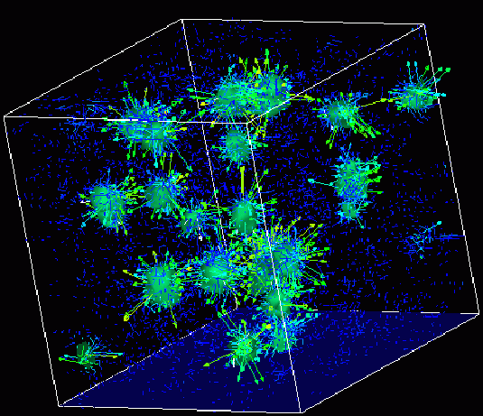
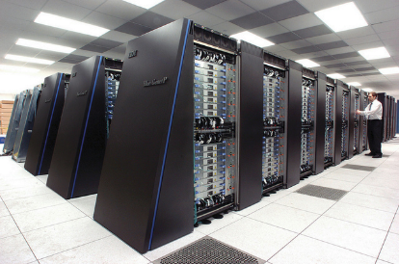
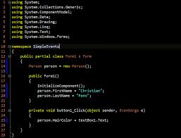
Survey of
Scientific Computing
(SciComp 301)
Dave Biersach
Brookhaven National Laboratory
dbiersach@bnl.gov
Session 16
3D Graphics,
Vector Algebra

Slide 2
Session Goals
Sizing the World Rectangle to frame polynomials
Review 3D Cartesian coordinates and oblique projection
Create a vertex array from a set of Point3D elements
Create a facet from a set of vertices
Draw a wireframe monolith and pyramid
Introduce spherical coordinates ($θ and φ$)
Draw a wireframe sphere and torus
Use vector cross product to perform back face culling
Use vector dot product to perform facet shading

Slide 3
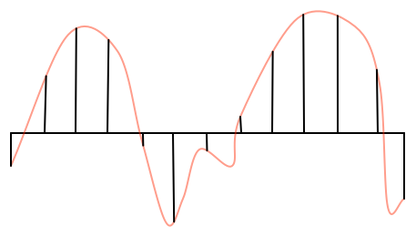
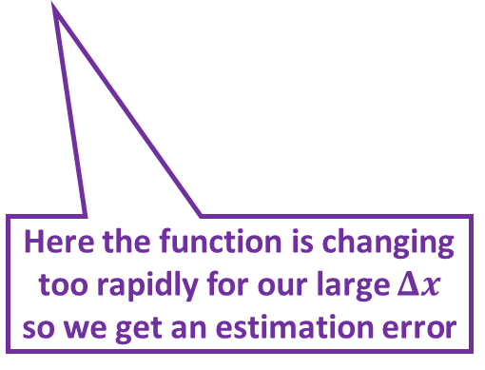
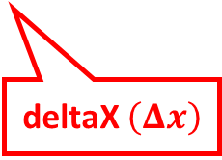
Drawing Curves using Intervals
deltaX $\left(Δx\right)$
We draw a curve by breaking it into small intervals of straight lines
Here the function is changing too rapidly for our large $Δx$ so we get an estimation error

Slide 4
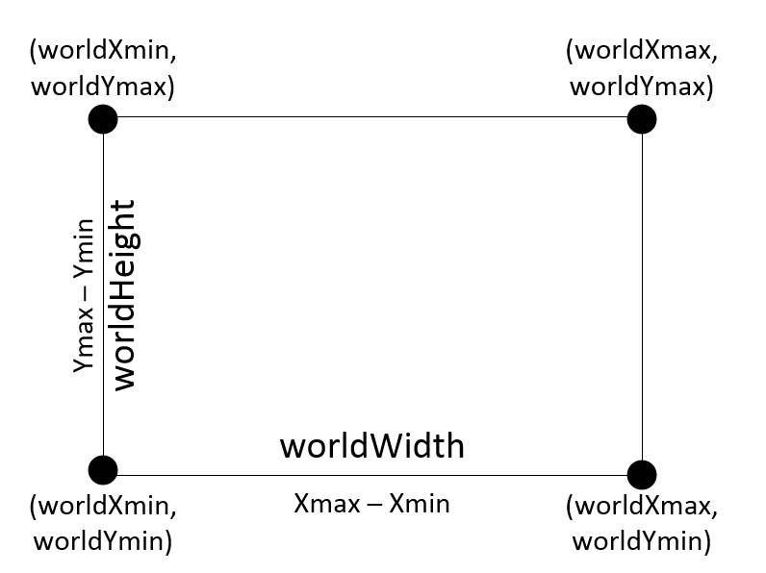

Bounding World Rectangle

Slide 5
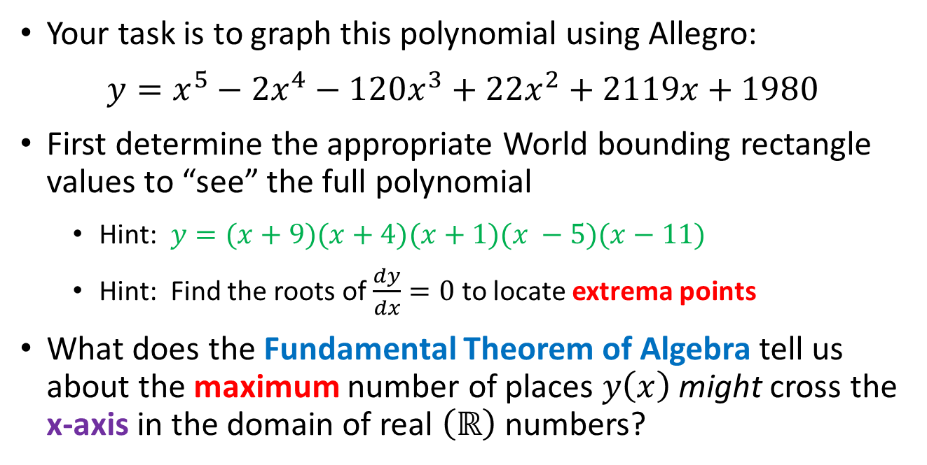
Drawing a Polynomial
Your task is to graph this polynomial using Allegro:
$y=x^{5}−{2x}^{4}−120x^{3}+22x^{2}+2119x+1980$
First determine the appropriate World bounding rectangle values to “see” the full polynomial
Hint: $y=(x+9)(x+4)(x+1)(x −5)(x−11)$
Hint: Find the roots of $\frac{dy}{dx}=0$ to locate extrema points
What does the Fundamental Theorem of Algebra tell us about the maximum number of places $y\left(x\right)$ might cross the x-axis in the domain of real $\left(ℝ\right)$ numbers?

Slide 6
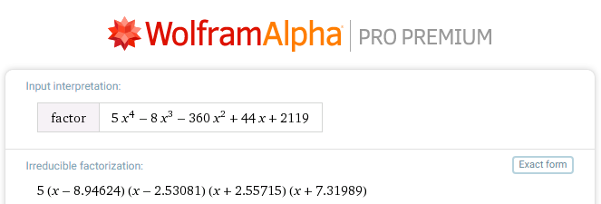
Finding Extrema
$$\frac{dy}{dx}=5x^{4}−8x^{3}−360x^{2}+44x+2119$$

Slide 7
Finding Extrema
$$\frac{dy}{dx}=5x^{4}−8x^{3}−360x^{2}+44x+2119$$
Best to include a point to the left and right of the zeros

Slide 8
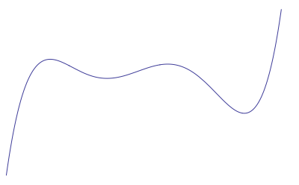
Finding Extrema
(12,31000)
Bounding
World Rectangle
(-10,-20000)
This bounding rectangle should be big enough to see all the interesting parts of the curve

Slide 9
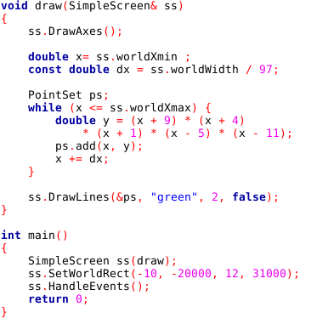
Open Lab 1 – Draw Polynomial
Prime number to minimize the chance of aliasing
Approximate the curve using small line segments
From the roots & extrema

Slide 10
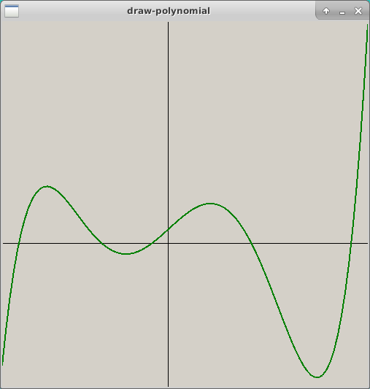
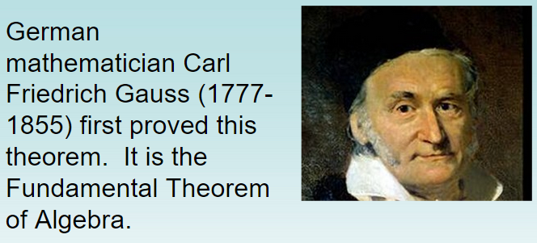
Run Lab 1 – Draw Polynomial

Slide 11
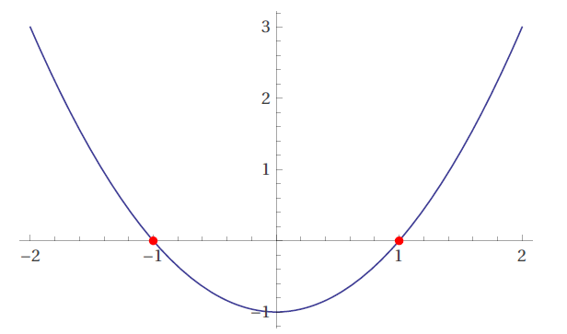
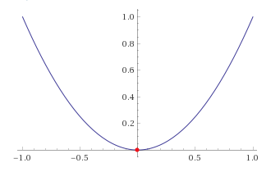
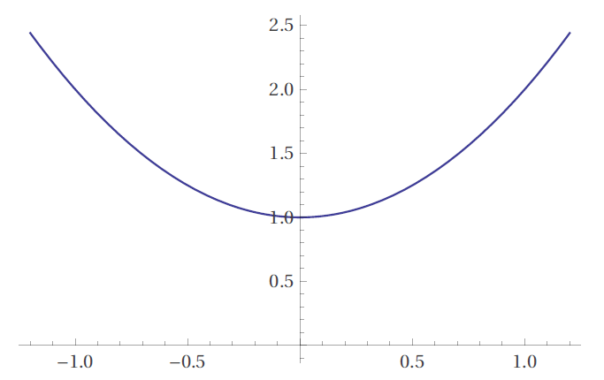






Polynomial Power & Complex Roots
$$y=x^{2}−1$$
Two real roots: $x=±1$
$$y=x^{2}$$
“Two” real roots: $x=0,0$
$$y=x^{2}+1$$
Two $ℂ$ roots: $x=±i$

Slide 12
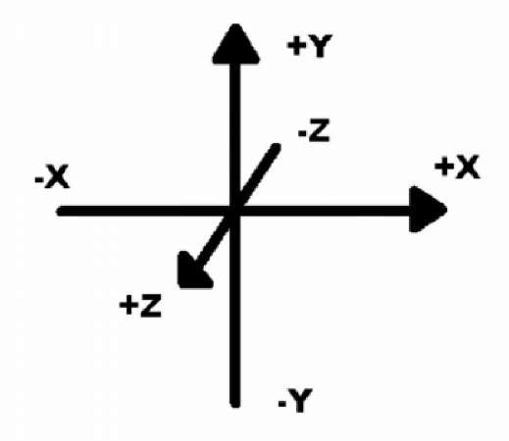
Axis Orientation in 3D
Objects father away have a more negative $z$coordinate value!

Slide 13
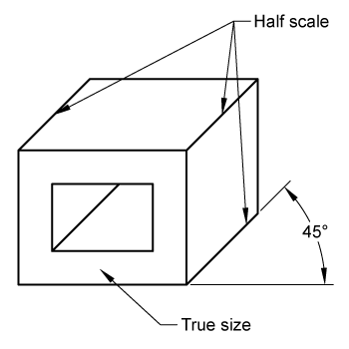
Oblique Projection
In 3-space (world coordinates), these two red points have the same X & Y coordinate values and only differ in their Z coordinate values
The back red point has only a more negative Z coordinate value than the front red point
y⁺
z⁻
x⁺

Slide 14
Oblique Projection
For screen coordinates (2D) to provide a partial sense of depth, the back red point needs artificially different X & Y coordinates than the front red point
We slightly adjust the perceived 2D (X,Y) coordinates of the back red point according to the value of its 3D (Z) coordinate
y⁺
x⁺

Slide 15
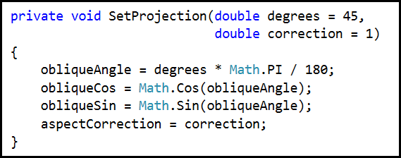
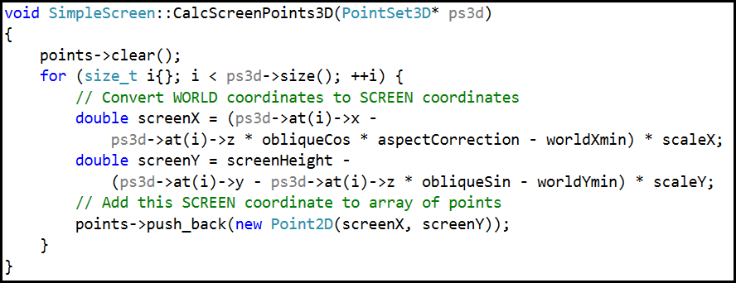
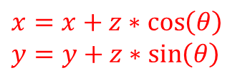
Oblique Projection
Decreasing $z$
y⁺
$$z$$
$$z\sin{θ}$$
$$θ$$
x⁺
$$z\cos{θ}$$
$$x=x+z∗\cos\left(θ\right)$$
$$y=y+z∗\sin\left(θ\right)$$

Slide 16
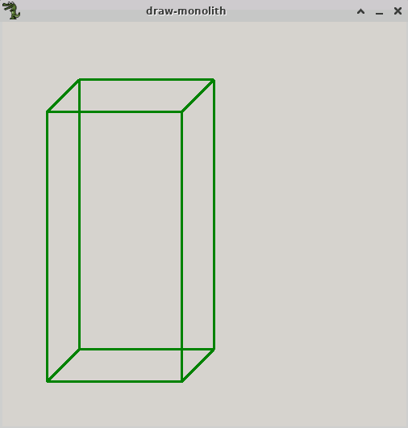
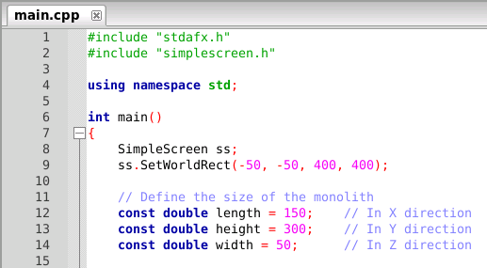
Open Lab 2 – Draw Monolith
height
width
length

Slide 17
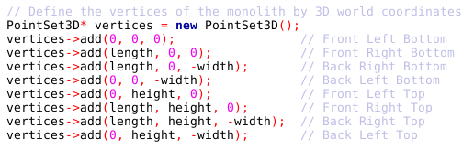

View Lab 2 – Draw Monolith
Step 1 : Define the Vertices
❼
❻
❹
❺
Y+
Z-
❸
❷
⓿
❶
X+
$$\left(0,0,0\right)$$

Slide 18
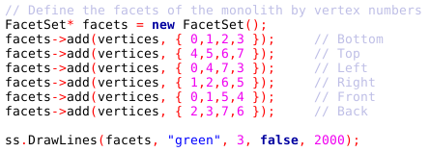
View Lab 2 – Draw Monolith
Step 2 : Define the Facets
❼
❻
❹
❺
Delay Count
❸
❷
⓿
❶

Slide 19
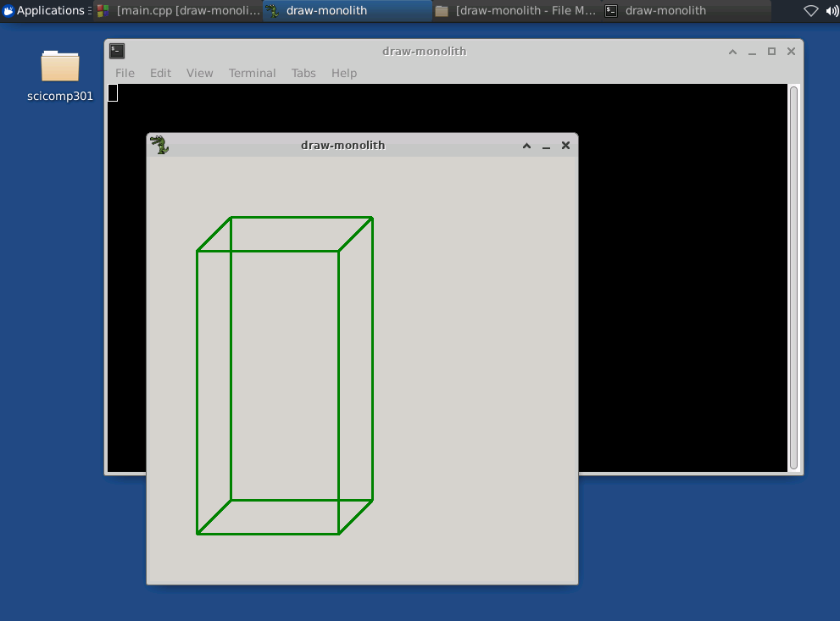
Run Lab 2 – Draw Monolith
Close the console window to stop an Allegro app

Slide 20
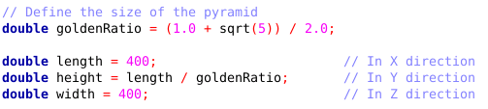
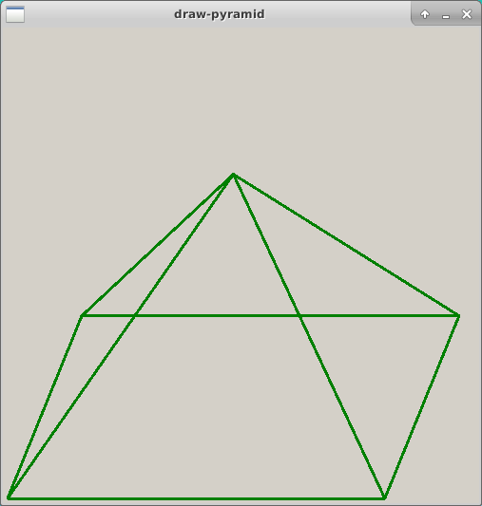
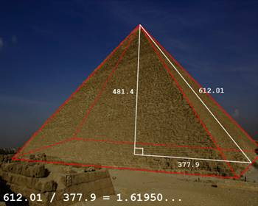
Open Lab 3 – Draw Pyramid

Slide 21
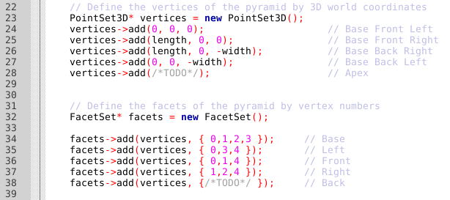

Edit Lab 3 – Draw Pyramid
❹
❸
❷
Remove the two
/* TODO */ comments in the definitions of both vertices and facets, and enter the correct code
⓿
❶

Slide 22
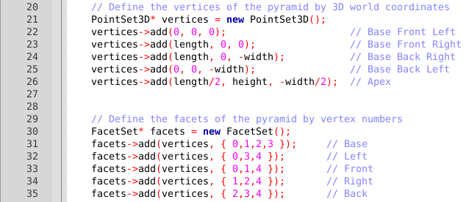
Edit Lab 3 – Draw Pyramid

Slide 23
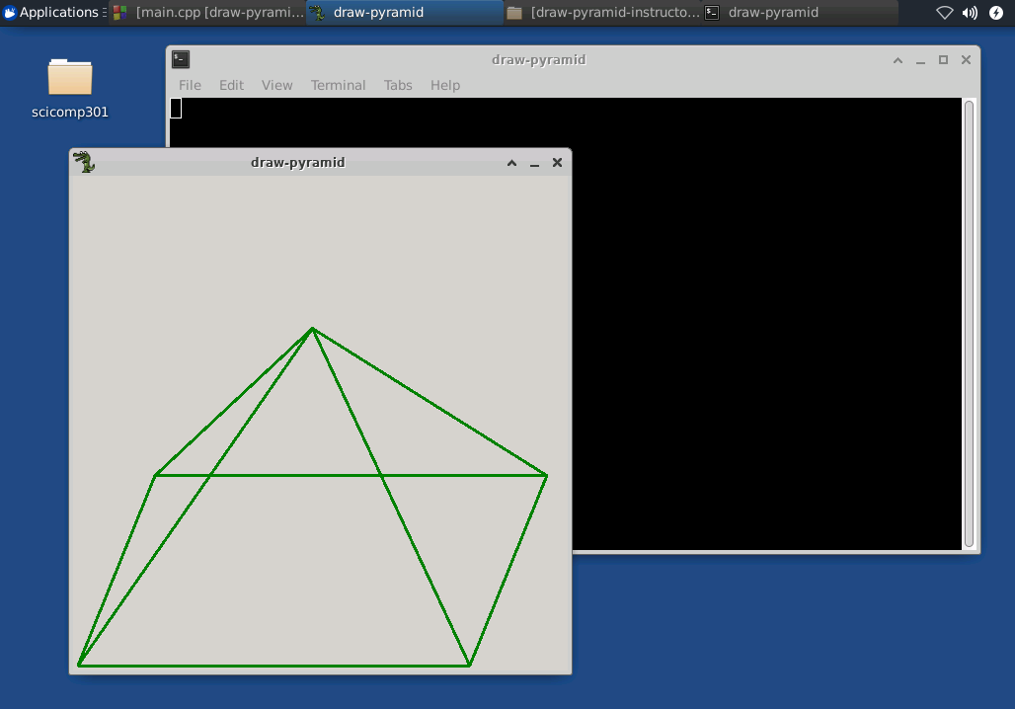
Run Lab 3 – Draw Pyramid
Close the console window to stop an Allegro app

Slide 24
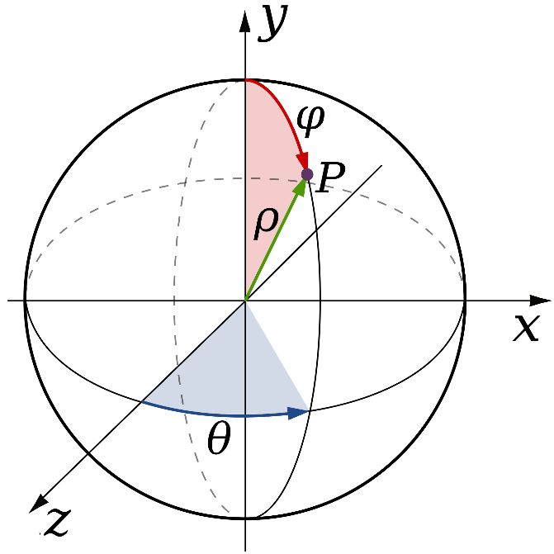
Spherical Coordinates

Slide 25
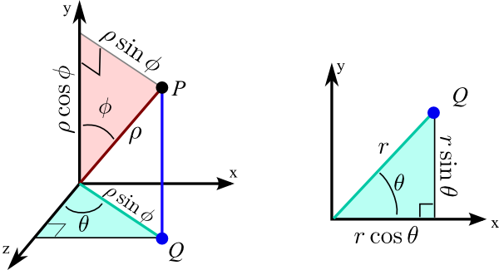
Spherical Coordinates
3D Spherical
2D Polar

Slide 26
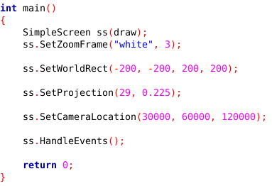
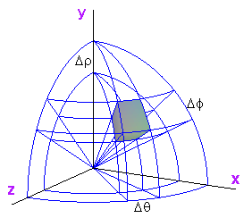
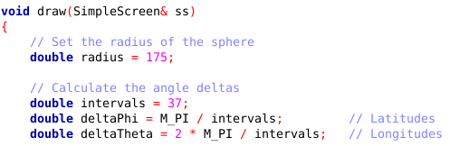
Open Lab 4 – Draw Spheres

Slide 27












View Lab 4 – Draw Spheres
$$φ=0$$
$$y^{+}$$
$$∆φ^{+}$$
$$\sin{ρ}$$
$$φ=\frac{π}{2}$$
$$θ=\frac{π}{2}$$
$$radius$$
$$ρ$$
$$r_{a}^{+}$$
$$θ=π$$
$$∆θ^{+}$$

Slide 28
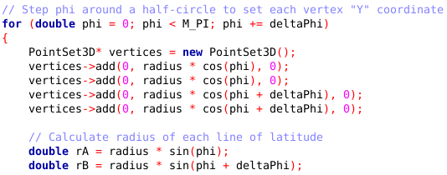






View Lab 4 – Draw Spheres
$$∆φ^{+}$$
❶
⓿
$$y^{+}$$
❷
❸
$$radius$$
$$\cos{ρ}$$
$$ρ$$
$$r_{a}^{+}$$

Slide 29
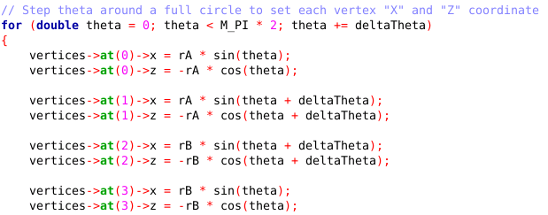
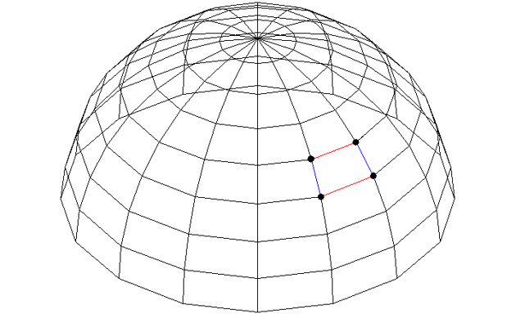







View Lab 4 – Draw Spheres
⓿
$$∆θ^{+}$$
❶
$$z^{−}$$
❸
❷
$$\sin{θ}$$
$$\cos{θ}$$
$$θ$$
$$r_{a}$$
$$x^{+}$$

Slide 30
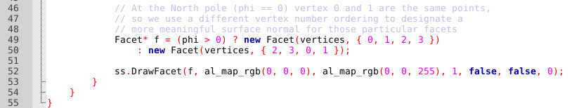
View Lab 4 – Draw Spheres
Vertex
Winding Order
(CCW)
⓿
❶
❸
❷

Slide 31
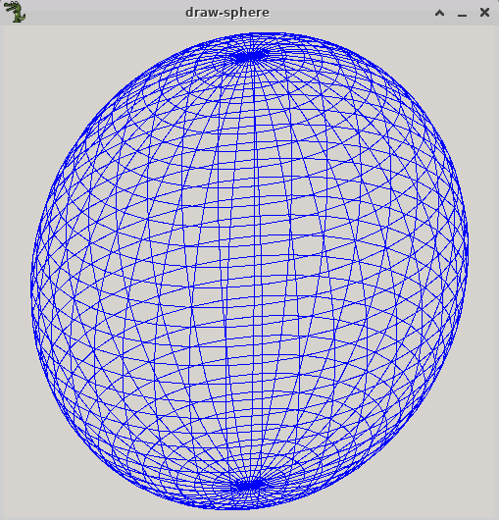
Run Lab 4 – Draw Spheres

Slide 32
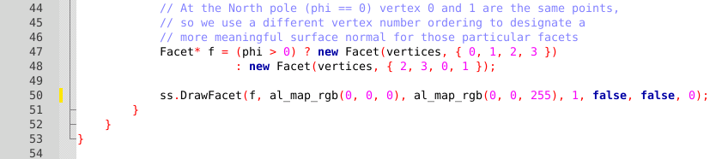
Edit Lab 4 – Draw Spheres
Delay Count

Slide 33
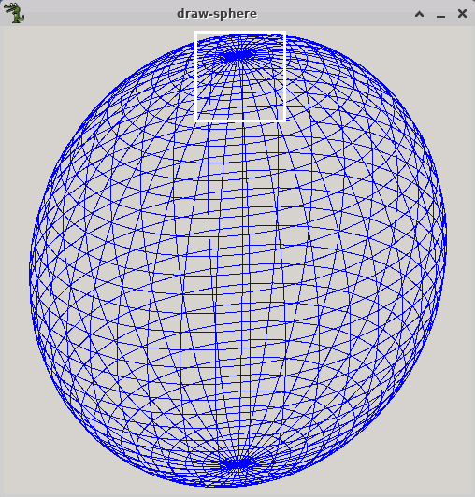
Run Lab 4 – Draw Spheres
Left click and drag to create a zoom rectangle

Slide 34
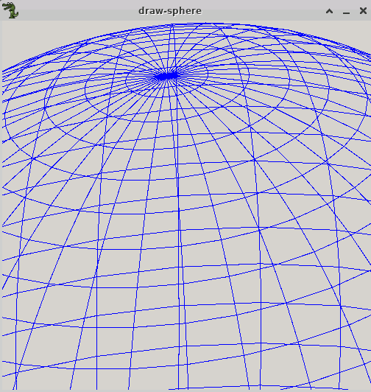
Run Lab 4 – Draw Spheres
Right click to restore the prior zoom state

Slide 35
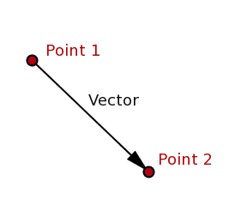
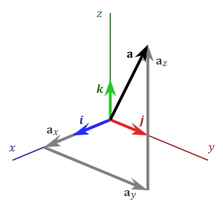
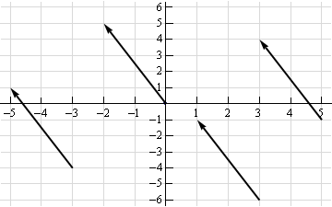
What is a vector?
$a_{x} a_{y} a_{z}$ are the components of
vector$\overset{⃑}{a}$
$$a_{x}={P2}_{x}−{P1}_{x}$$
$$a_{y}={P2}_{y}−{P1}_{y}$$
$$a_{z}={P2}_{z}−{P1}_{z}$$

Slide 36
What is a vector?
How do we avoid drawing the facets which are on the back of the sphere?
$$\overset{⃑}{a}$$
⓿
❶
$$\overset{⃑}{b}$$
❷

Slide 37
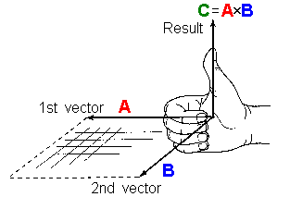
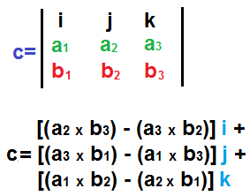

Vector Cross Product
The cross product of two vectors is another vector which is perpendicular to both vectors A and B

Slide 38




Every Facet has a Surface Normal Vector

Slide 39


Vector Dot Product
The dot product gives the angle between two vectors

Slide 40




Back Face Culling and Facet Shading
$$\vec{n}$$
Camera / Eye Location
$$θ$$

Slide 41

Back Face Culling

Slide 42

Edit Lab 4 – Draw Spheres
Enable
Back Face Culling

Slide 43

Run Lab 4 – Draw Spheres
Back Face Culling removes hidden surfaces

Slide 44

Facet Shading

Slide 45

Edit Lab 4 – Draw Spheres
Enable
Facet Shading

Slide 46

Run Lab 4 – Draw Spheres
Facet Shading enables variable illumination

Slide 47




Drawing a Torus
A torus and a sphere are not homeomorphic as we need two defining radii for a torus
$$R_{1}$$
$$R_{2}$$

Slide 48


Open Lab 5 – Draw Torus
We are still using spherical coordinates, so we loop first on $φ$ then on $θ$

Slide 49

Run Lab 5 – Draw Torus

Slide 50



View Lab 5 – Draw Torus
The green component scales from 130 (dark) to 190 (light) based upon how much the facet normal points at the illumination source

Slide 51

Edit Lab 5 – Draw Torus
Enable
Facet Shading

Slide 52


Run Lab 5 – Draw Torus

Slide 53
Now you know…
We can use the zeroes and extrema of a polynomial to determine an appropriate world rectangle to frame it
3D Cartesian coordinates use$\left(x,y,z\right)$ while 3D Spherical coordinates use $(r, θ, φ)$
An oblique projection (2.5D) shows a ¾ “side” view
Sets of vertices are assembled into facets
A surface normal vector is a cross product of two facet edge vectors following the right-hand rule
A dot product expresses the angle between two vectors
The dot product between the camera vector and each facet normal enables back face culling and facet shading

